Slide 1
IBM DB2 INSTALLATION
LINUX OPERATING SYSTEM

Slide 2
CONTENTS
Installation Steps
Validation
Database Creation

Slide 3
INSTALLATION

Slide 4
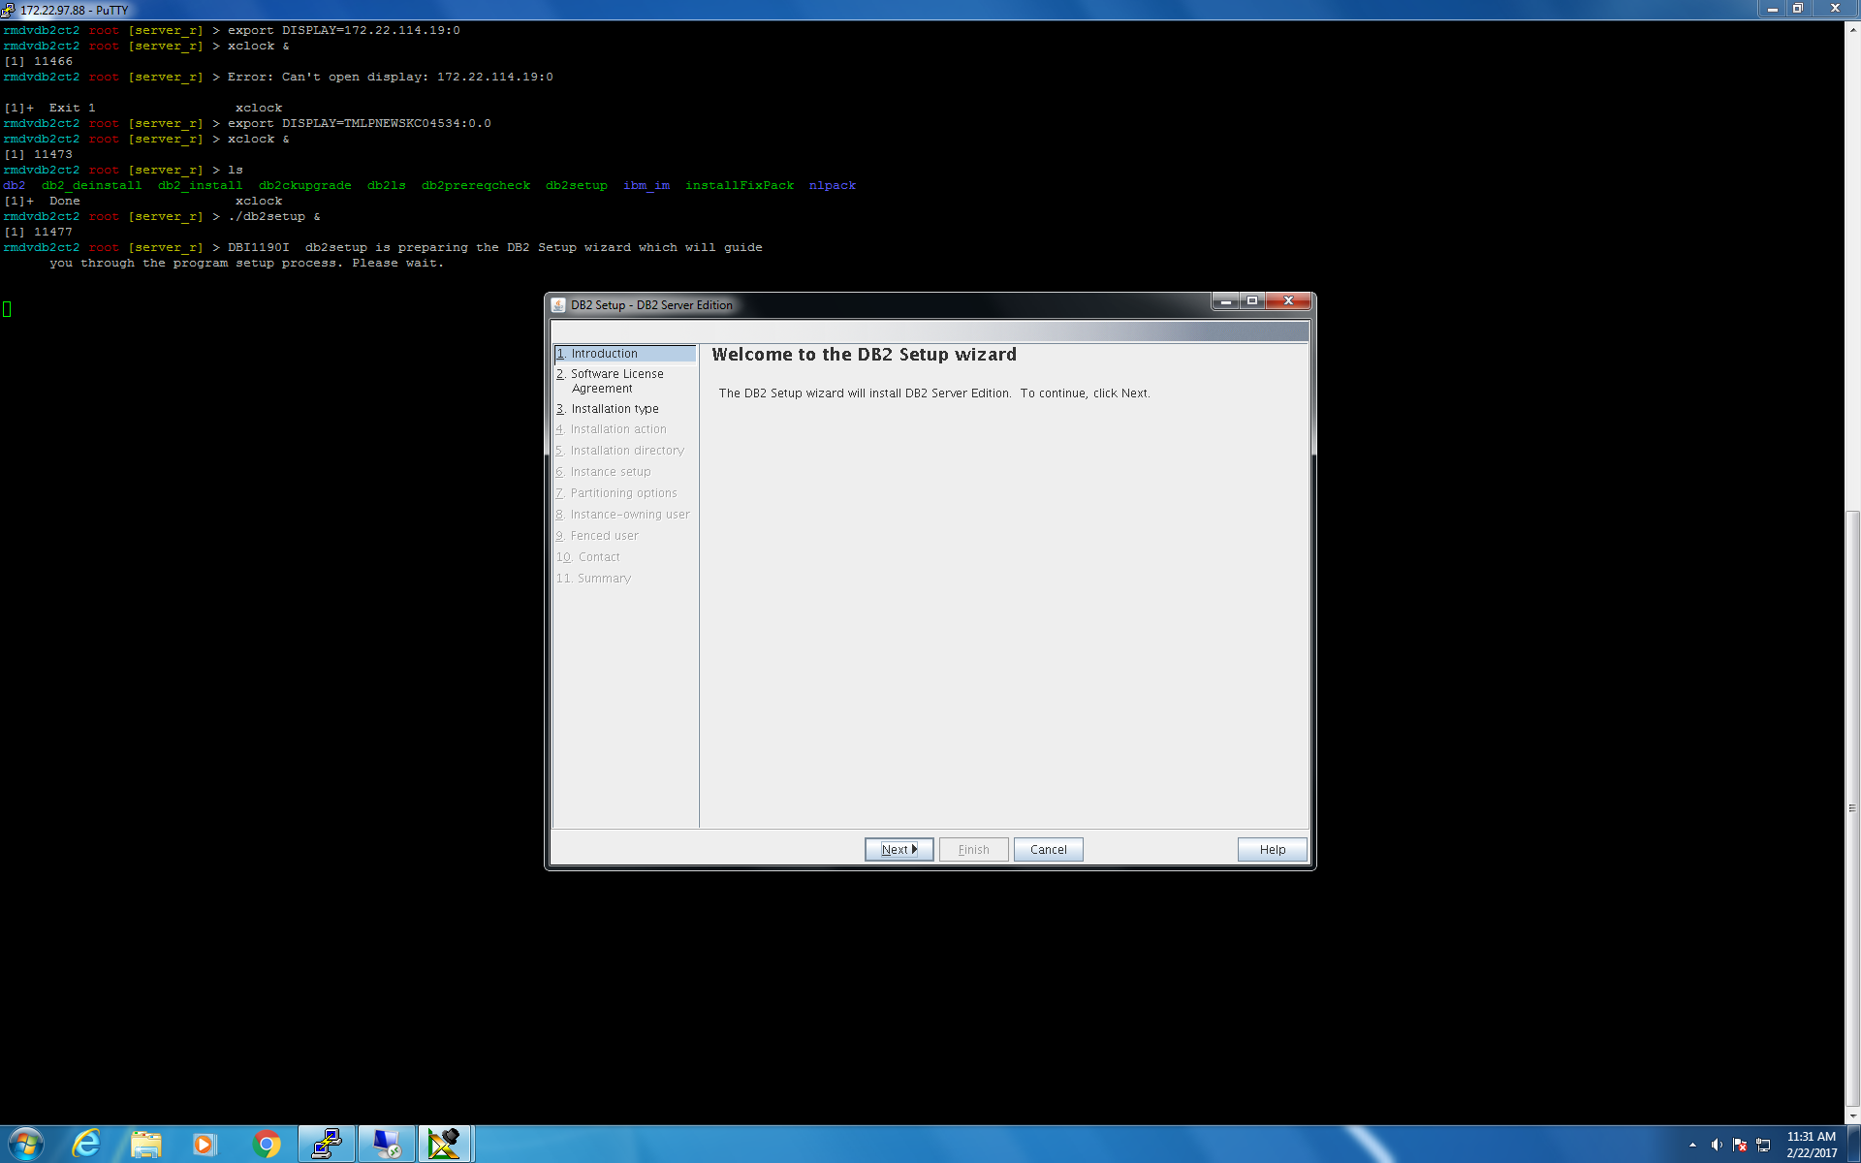
Step 1 :- Introduction

Slide 5
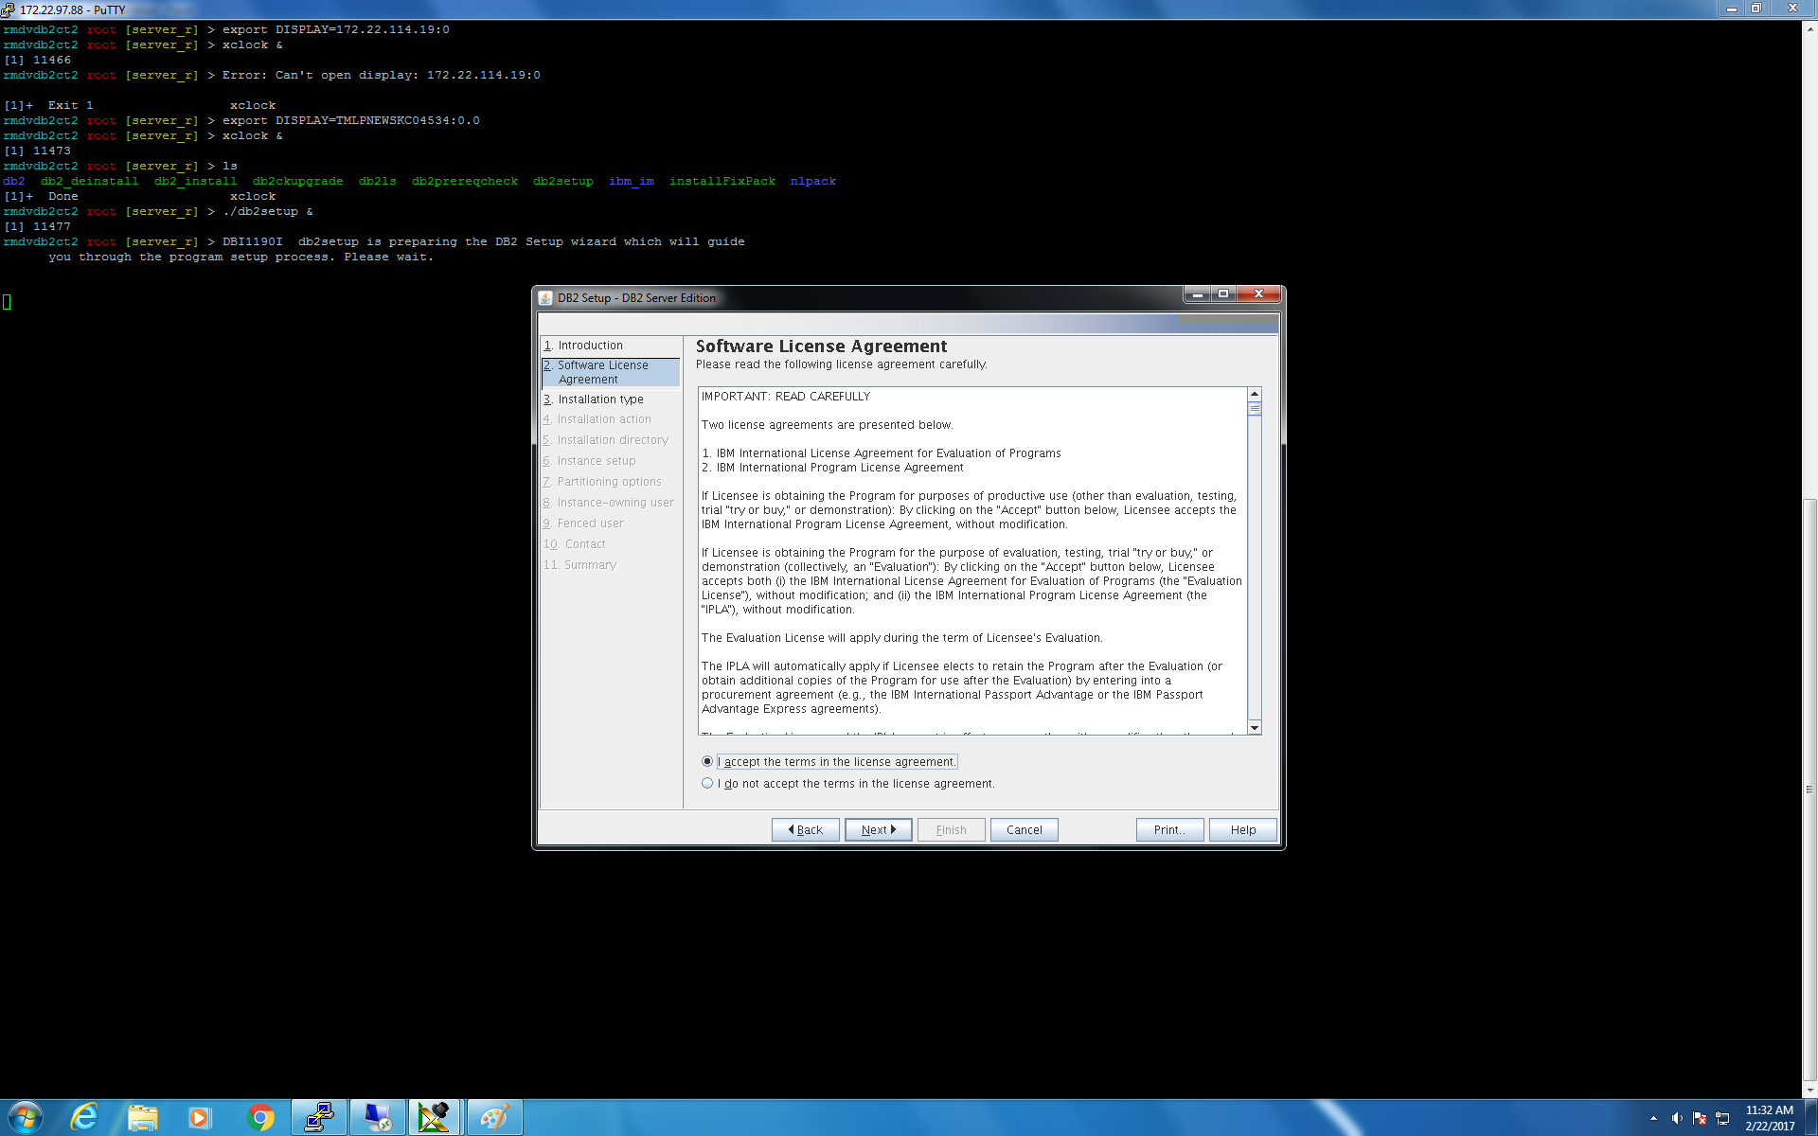
Step 2 :- Software License Agreement

Slide 6
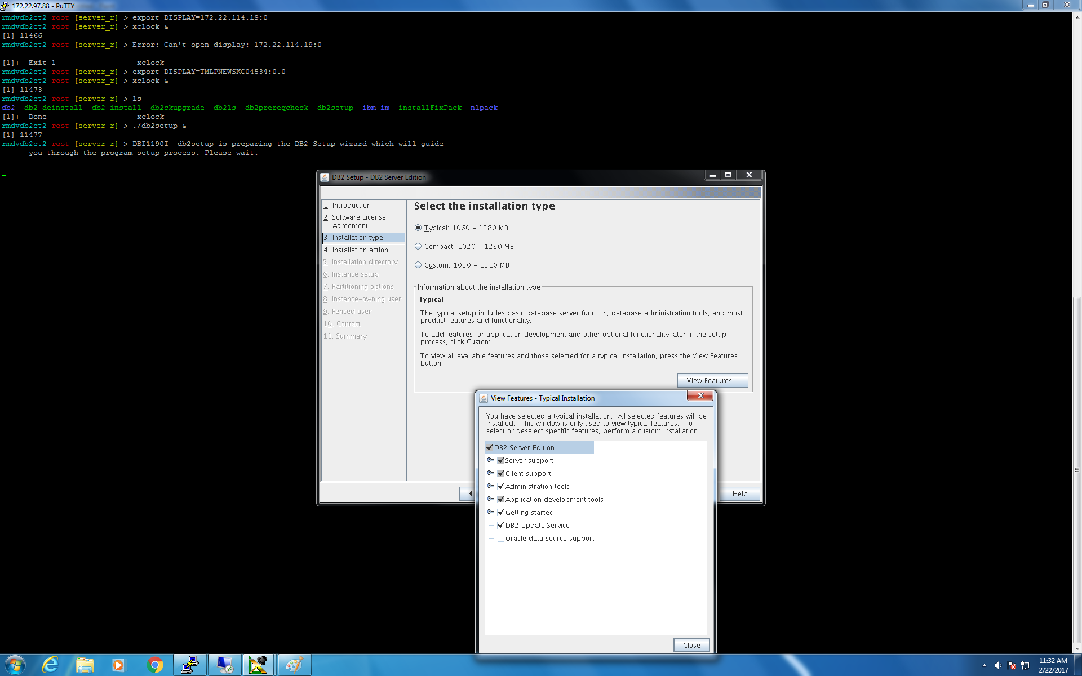
Step 3 :- Installation Type

Slide 7
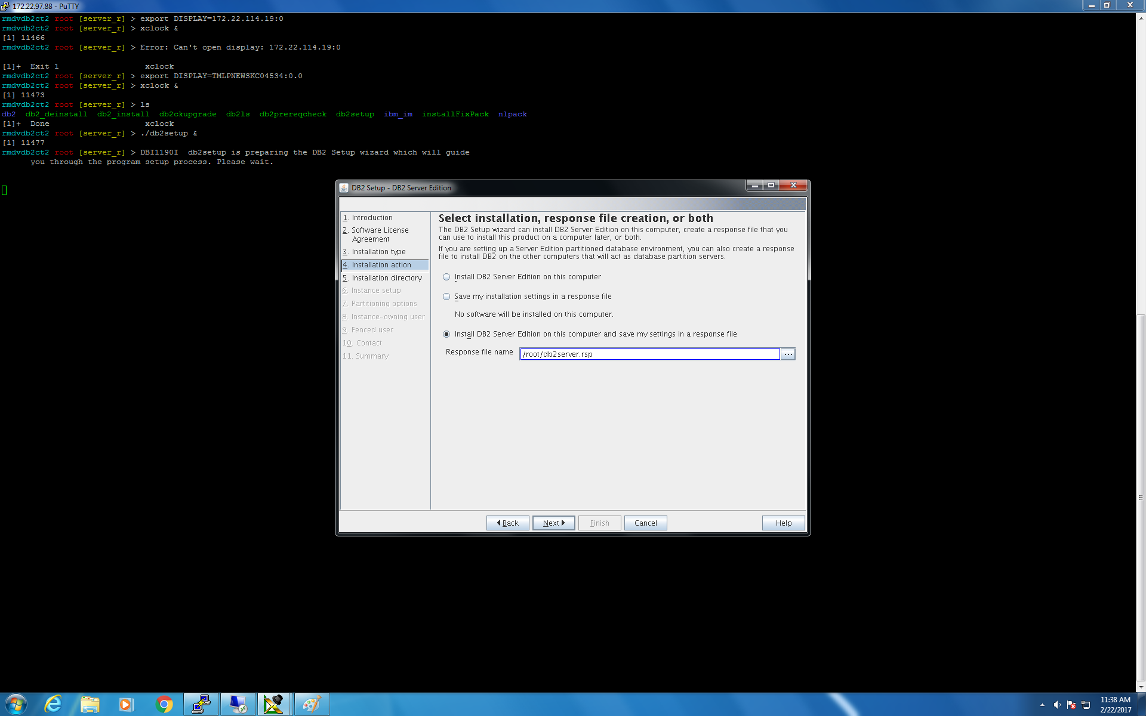
Step 4 :- Installation Action

Slide 8
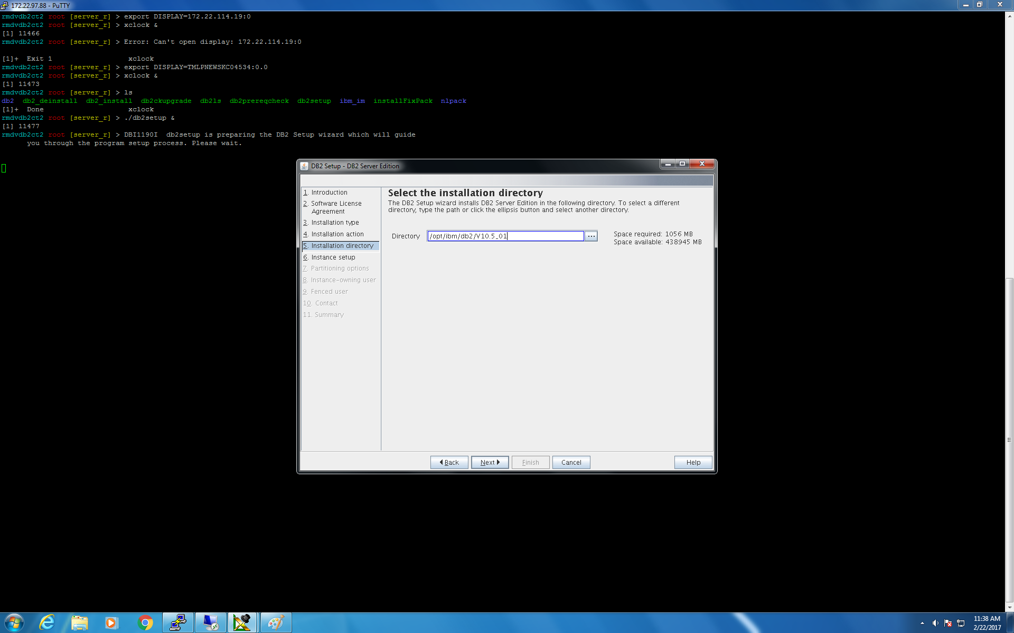
Step 5 :- Installation Directory

Slide 9
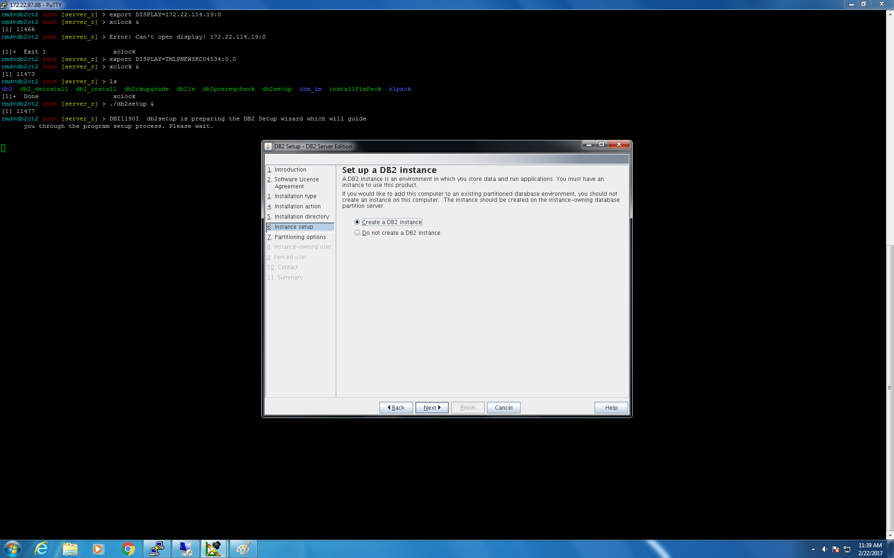
Step 6 :- Instance Setup

Slide 10
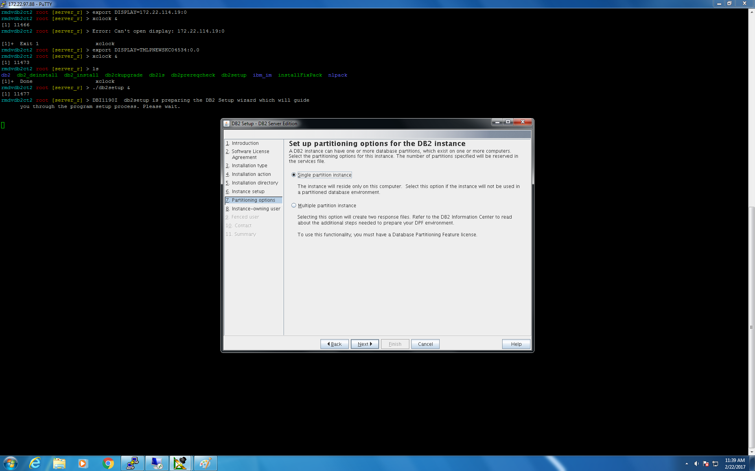
Step 7 :- Partitioning Options

Slide 11
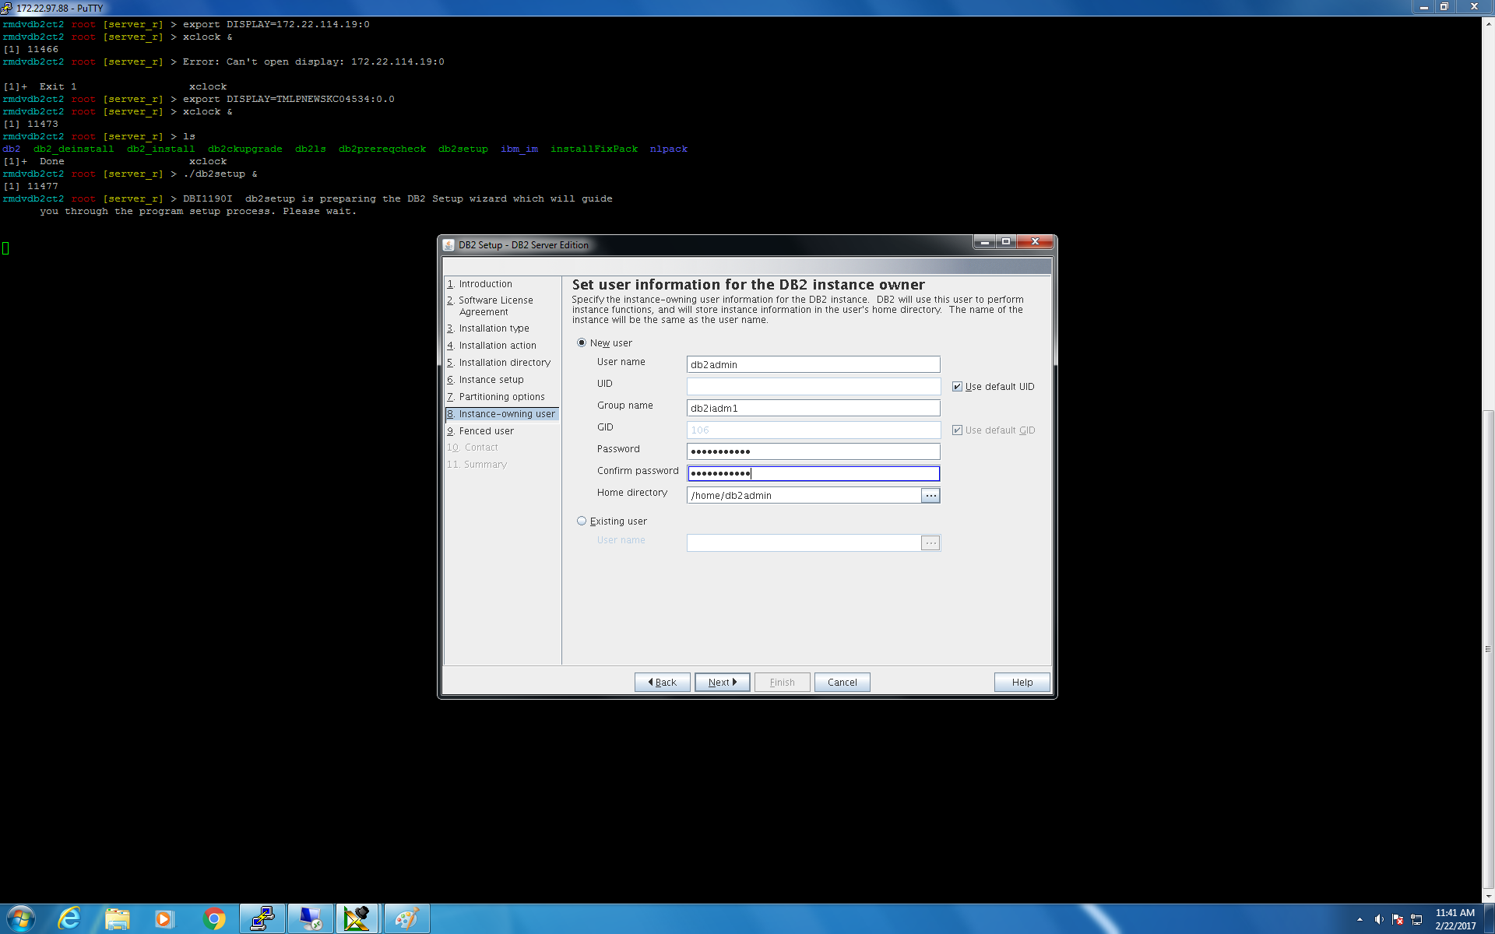
Step 8 :- Instance – owning user

Slide 12
Step 9 :- Fenced User

Slide 13
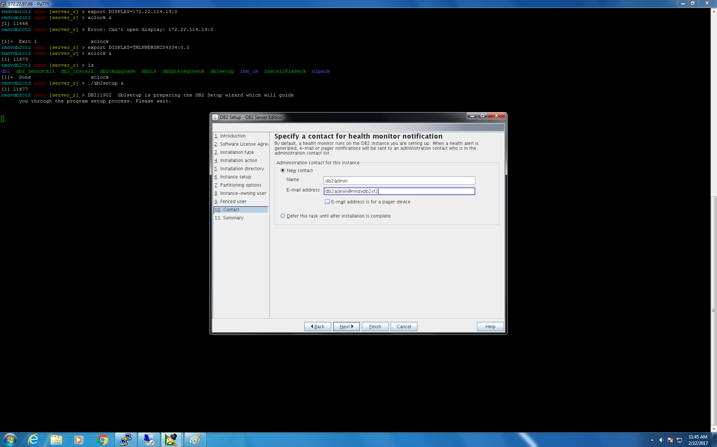
Step 10 :- Contact

Slide 14
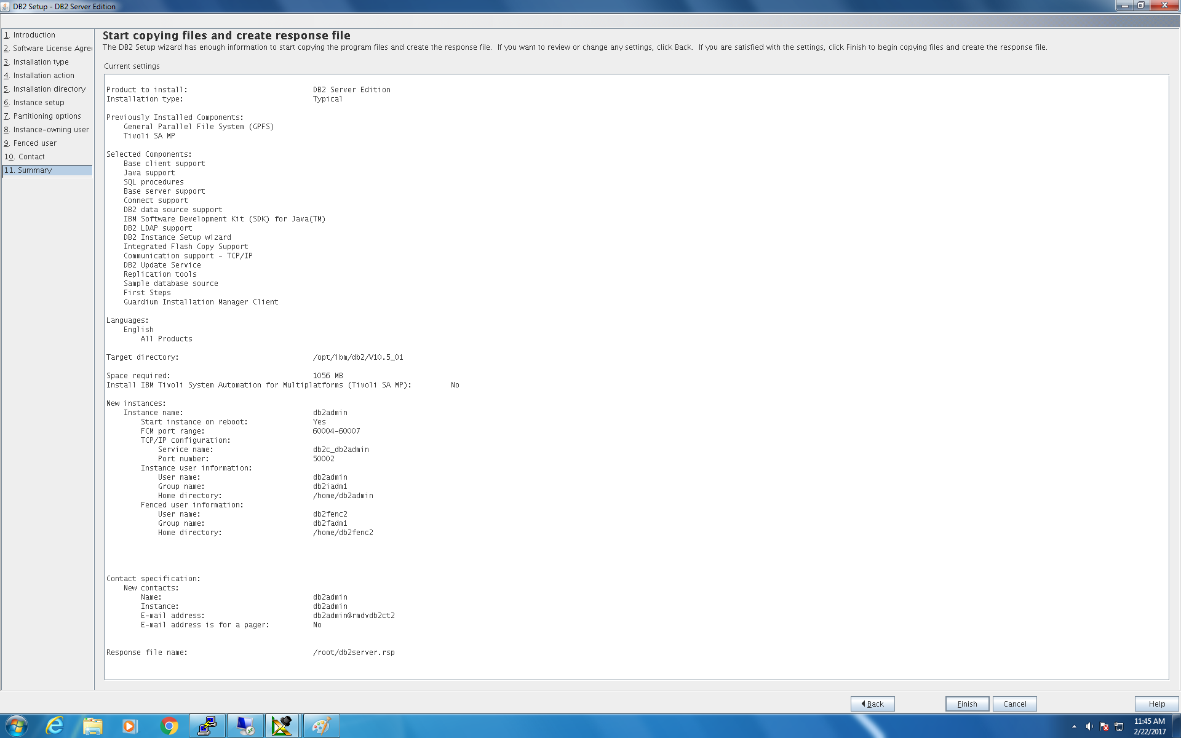
Step 11 :- Summary

Slide 15
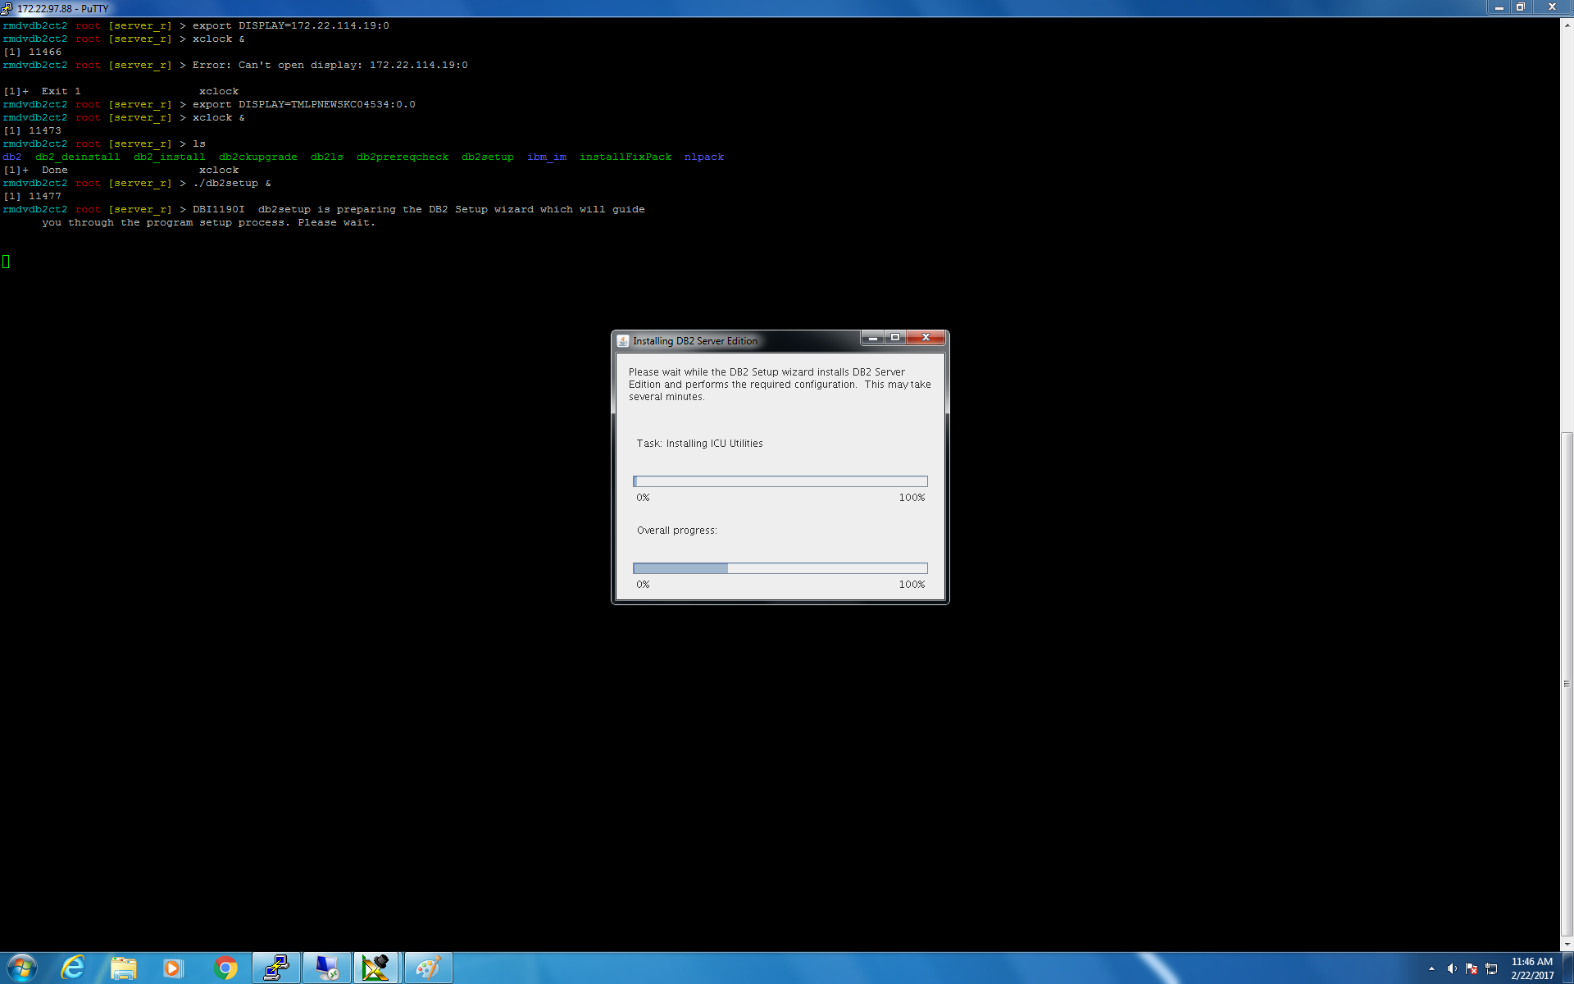
Installing DB2

Slide 16
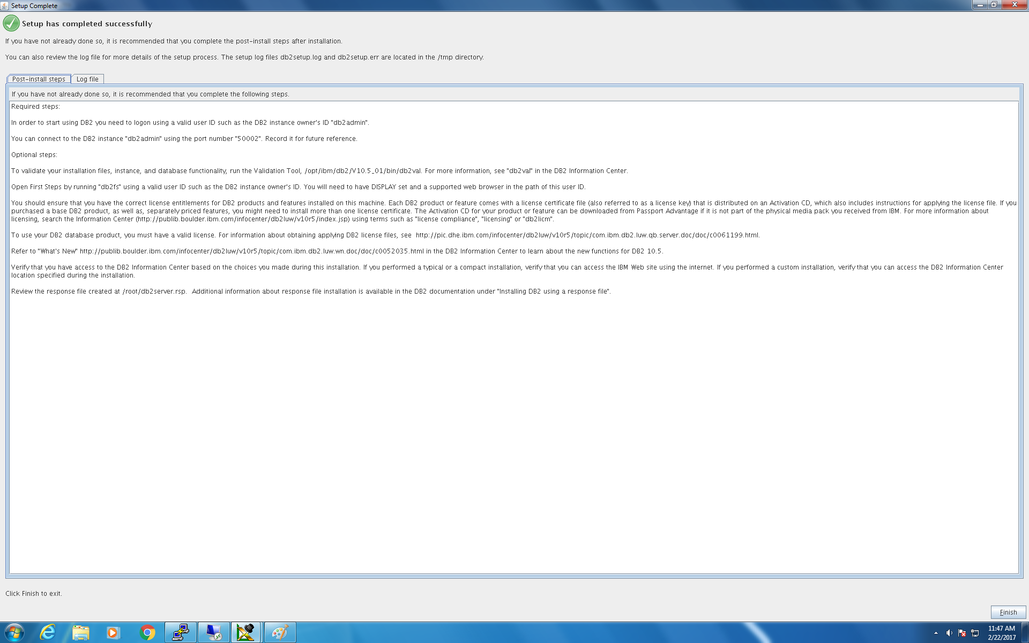
Post-install Steps

Slide 17
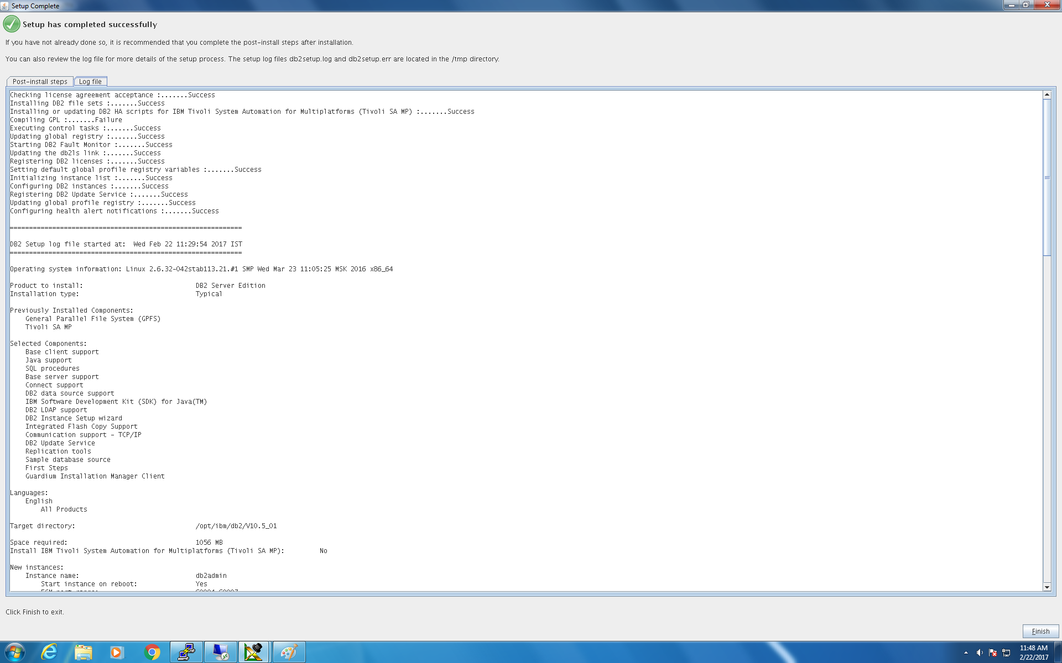
Log File

Slide 18
VALIDATION

Slide 19
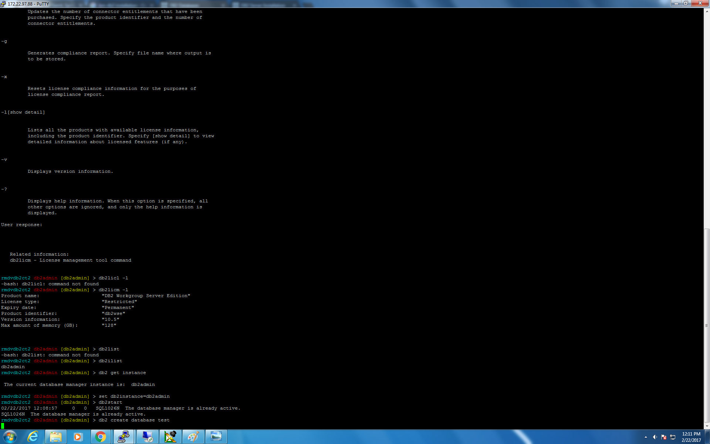
Testing DB2 Installation

Slide 20
DATABASE CREATION

Slide 21
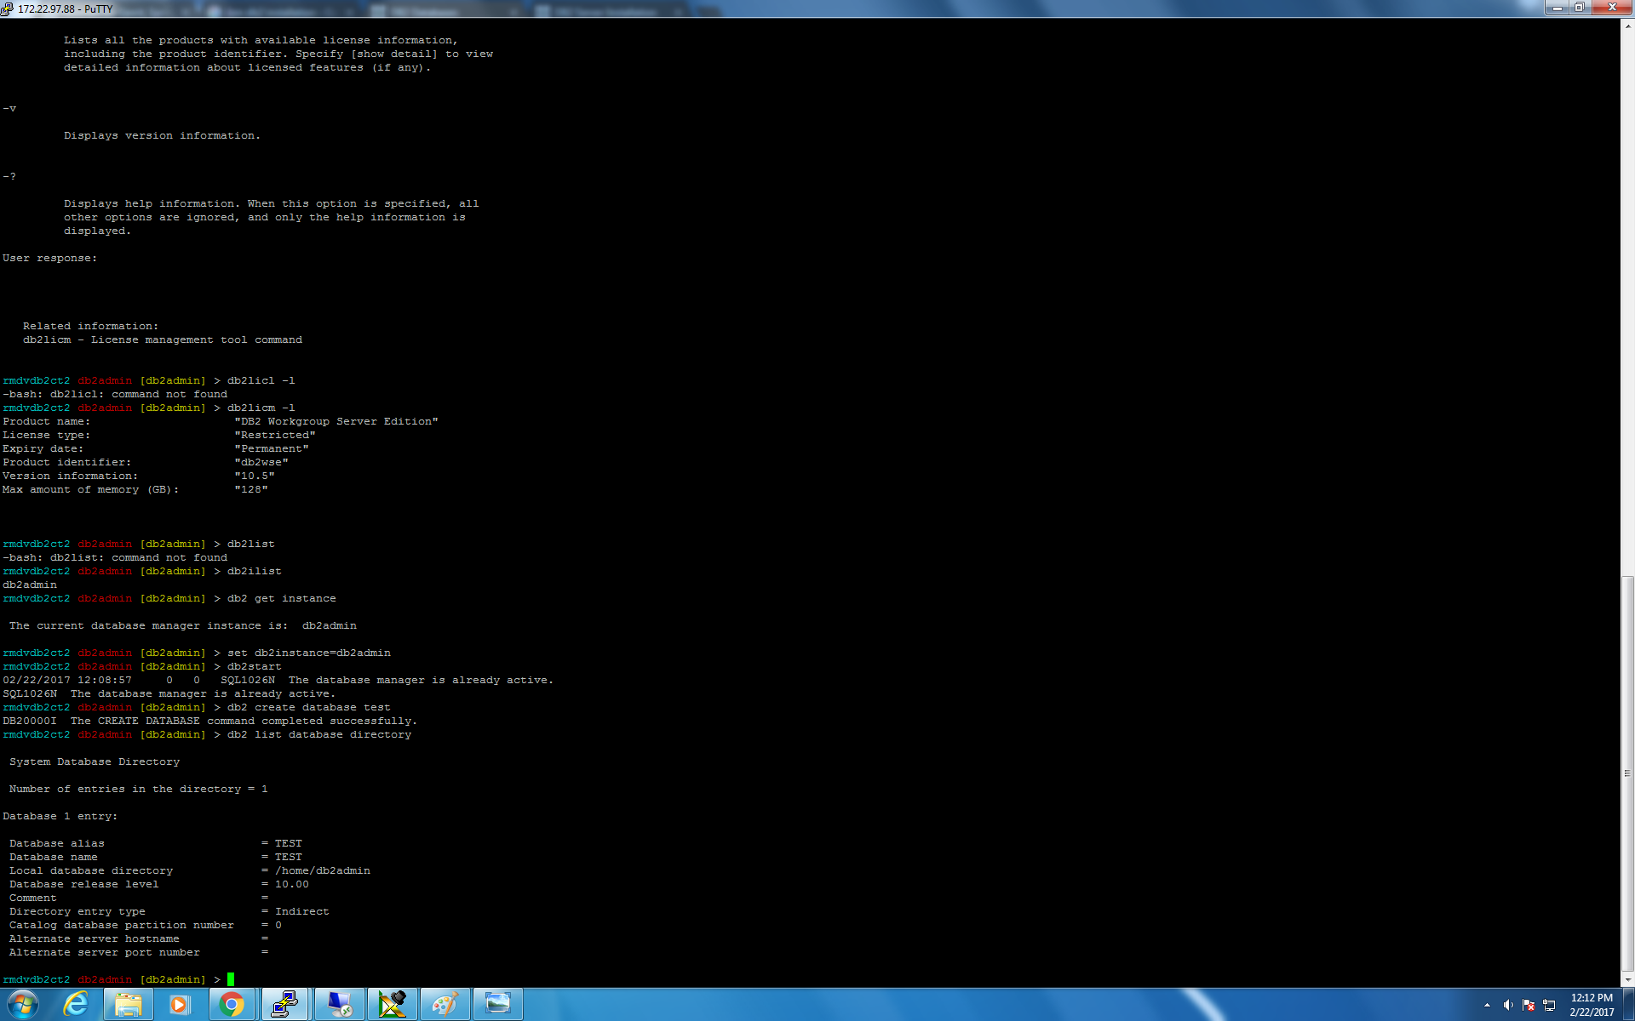
Creation of Test Database

Slide 22
THANK YOU

